Slide 1
Project 1 R Data analysis
Daniel Antonio Arana

Slide 2
Salary Distribution (USD)
Description of the histogram:
This histogram show the overall distributions of salaries in US dollars for all employees in the provided dataset.
Purpose of the histogram:
This histogram Helps identify the general trend (range and frequency) of salaries.
Are most salaries grouped around a particular range
Graph Description:
X axis: Salary in US dollars.
Y axis: Frequency of employees within each salary frequency (the cluster).
Shows the overall spread of salaries for all employees in the dataset.
Insights:
You’ll (CEO) likely observe a right cluster distribution, indicating that most salaries are clustered around lower ranges, with fewer employees earning particularly high salaries.
The range of salaries provides an idea of the typical earnings in the field of data science careers.
We can identify salaries categorized as outliers (high-paying job positions) and consider these for positions requiring specialized skills.

Slide 3
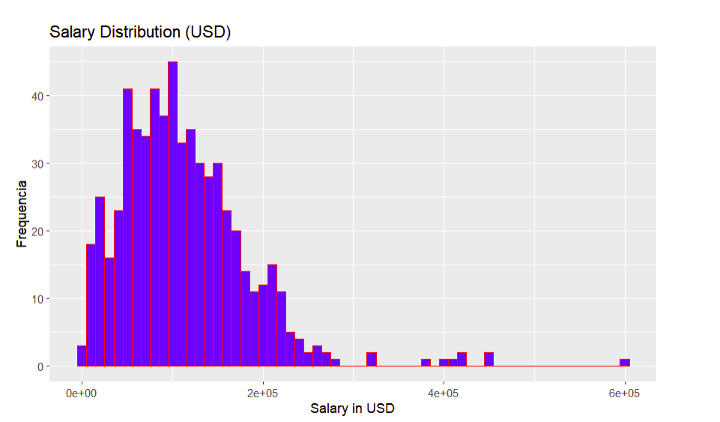

Slide 4
Salary Comparison histogram USA Based vs Offshore
Description:
This histogram compares the salary distributions for employees based in the United States in contrast to those who are offshore.
Graph Description:
•X-axis: Salary in US dollars
•Y-axis: Frequency of employees
•Two overlaid in this histograms showing the salary distributions for U.S.-based employees versus offshore ones.
Insights:
•US-Based Salaries: Typicallyhigher due to a competitive market and cost of living.
•Offshore Salaries: Tend to be lower, providing cost advantages for the company.

Slide 5
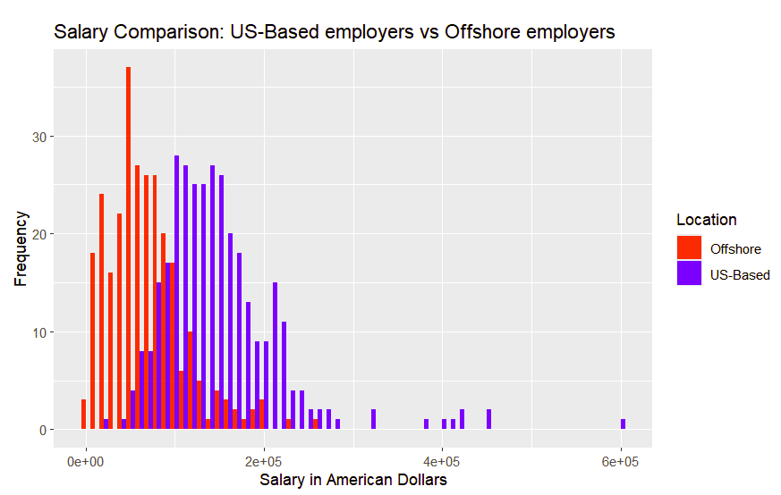

Slide 6
Salary Distribution by Experience Level
Description of the histogram:
This histogram divides the salary data based on experience levels (Entry-level, Mid-level, Senior-level, Executive level). Each group has its own colors.
Insight 1: This allows you to see trends, such as higher salaries for Senior and Executive roles, and helps ensure that the company offers competitive rates for various experience levels.
Graph Description:
•X-axis: Salary in US dollars.
•Y-axis: Frequency of employees.
•Colored bars show the distribution for different experience levels (Entry-level, Mid-level, Senior, and Executive)
Insights 2:
•Entry-Level or (EN): Salaries are concentrated at the lower range, which is expected.
•Senior/Executive (SE/EX): Salaries tend to occupy the higher range.
•The histogram highlights how experience correlates with salary.

Slide 7
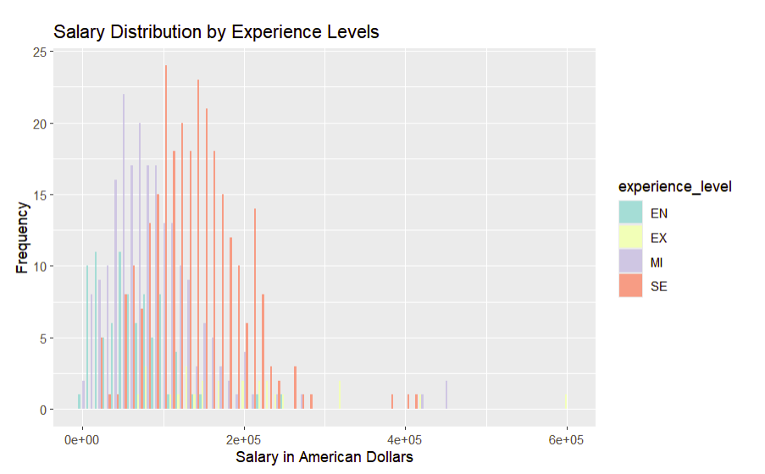

Slide 8
Remote Work Ratios
This histogram shows the frequency of different remote work ratios (no remote work, partially remote, fully remote).
Understand how many employees work remotely and to what extent.
Assess if there is any correlation between remote work and salary.
Insights: If remote work is prevalent, the company could leverage this to attract talent by offering flexible work arrangements regardless if they are based in the USA or not.
Graph Description:
X-axis: Percentage of remote work (0, 50, 100 percent).
Y-axis: Frequency of employees.
0% or No Remote Work: Indicates onsite roles, which may have different payments, 50% or Hybrid Work: Shows a balance between remote and office work, 100% Fully Remote: This growing trend, is potentially associated with cost savings and global talent options.
Deeper insights (Key Observations):
A significant peak at 100% suggests a growing preference for fully remote roles, which aligns with industry trends of increased remote work opportunities.
A large proportion of roles categorized as 100% remote suggests that many companies are embracing remote work, possibly tapping into a global talent pool and reducing overhead costs associated with physical offices.

Slide 9
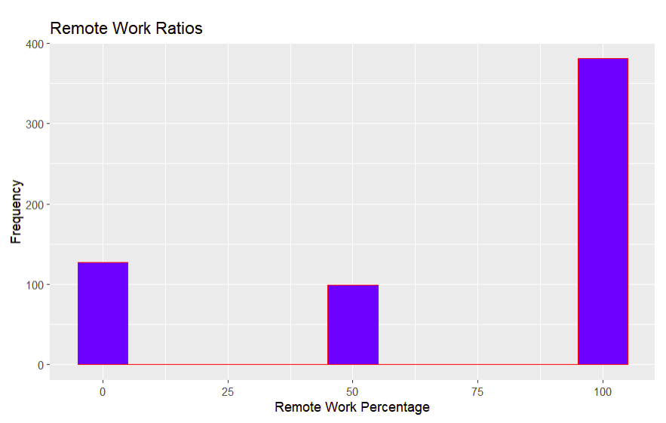

Slide 10
Salary Implications:
Fully remote roles may allow companies to hire employees in regions with lower living costs, potentially offering salary savings.
On-site roles may require higher salaries to lure talent, particularly in highcost areas like here in the United States (Boston)
Hybrid roles may carry unique costs, such as travel or partial relocation, but the inconvenience can be reduced if facilities are provided to employees
Conclusion of for the company:
This company can benefit from a higher proportion of fully remote roles, as they are easier to find and attract to the company and the company will save resources in infrastructure for large scale office spaces.

Slide 11
Average Salaries by Job Title (in USD)
Salary Differentiation by Job Title:
First is notorious that the histogram shows that salaries vary significantly depending on the job title.
The high paying roles, such as Machine Learning Scientist and Machine Learning Engineer, salaries are significantly above the average, reflecting the compensation on specialized AI and engineering skills in contrast, roles such as Product Data Analyst and Entry Level Data Science positions exhibit lower average salaries.
Market Competitiveness area:
For competitive positioning, focus on aligning with higher salary bands for roles critical to the organization's growth, especially for positions requiring advanced technical expertise such Senior Data Scientist or ML Scientist.
Recommendation:
Evaluate offshore options for roles with broader global talent options but maintain a compensation for US-based employees due to higher living costs and market rates.

Slide 12
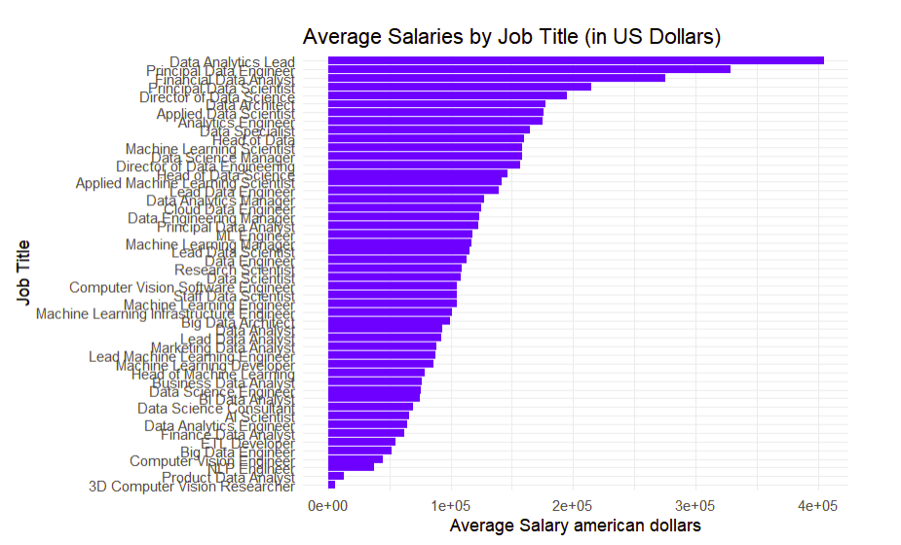

Slide 13
What is the salary trend offshore?
We can visualize in the histogram the distribution of offshore salaries (in US dollars)
Salary Concentration:
Offshore salaries exhibit a concentration in the mid ranges, with a significant number of salaries clustering between $50,000 and $100,000.
Outliers among the data:
A small number of salaries exceed $150,000, highlighting the presence of high paid offshore talent, likely for specialized or executive roless.
Reasons:
Competitiveness:
This distribution indicates that offering salaries around the $75,000 to $120,000 range could attract a majority of offshore talent, depending on their skillset and experience.
Cost Advantage:
Compared to U.S salaries, these offshore candidates suggest potential cost efficiencies while accessing global talent.
A suggestions for better strategic hiring would be aiming for salaries slightly above the median offshore range could position the company as a competitive employer, ensuring access to top tier talents and therefore increasing productivity in the company

Slide 14
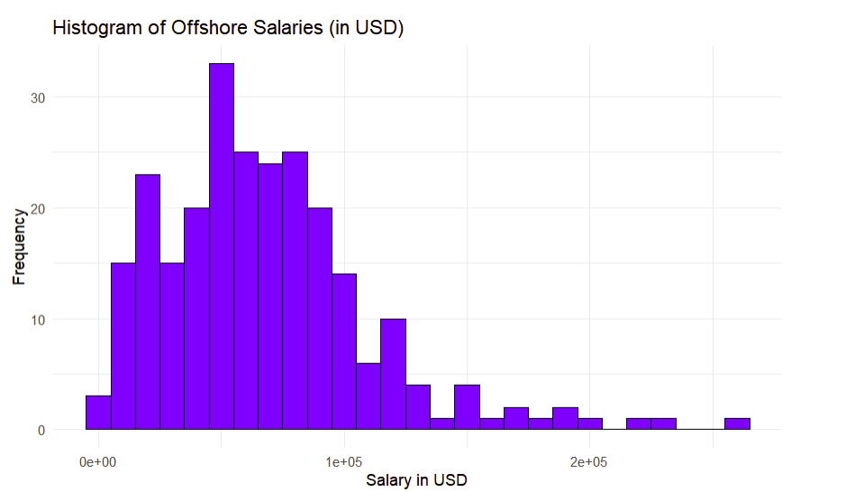

Slide 15
Retain Competitive Advantage Through Remote Work
Based on the provided data and an understanding of remote work effects in the data, here's a detailed list of suggestions, advantages, and disadvantages for the company to a shift toward remote work:
Suggestions for Remote Work Adoption:
Develop a Remote Work Policy (A clear one): Establish clear guidelines regarding expectations, tools, and collaboration strategies for remote employees.
Utilize Technology: Invest in project management tools, video conferencing platforms, and asynchronous communication to ensure effective collaboration, especially with offshore employes.
Offer Flexibility to those who still onsite: Provide employees the choice to work fully remote or hybrid to enhance satisfaction and productivity.
Advantages of Remote Work (Cost related)
Cost Savings:
Reduced need for office space, utilities, and other (especially rent) on-site expenses.
Offshore employees may demand lower salaries compared to USA based employees, allowing cost-effective scaling.
Access to a Global Talent:
Enables hiring from regions with high expertise at competitive salary levels, especially evident in the offshore salary trends from the data.
Environmental Impact
Reduction in commuting and office energy consumption will potentially help to mitigate carbon footprint
Enhanced Diversity
Diverse perspectives from international employees improve innovation and decision-making through the addition of new ways of thinking.

Slide 16
Disadvantages of Remote Work:
Potential Communication Gaps
Without strong systems, remote teams may face challenges in coordination and communication in delicate projects.
Cultural and Time Zone Differences
Hiring globally introduces potential misalignments in work hours and cultural misunderstandings (especially if the employees speak another language)
Onboarding and Training Challenges (potentially but not certain)
New employees may find it harder to integrate and learn without in-person interactions.
Security Risks (although this could happen on-site)
Handling sensitive data across remote environments increases cybersecurity concerns.
Performance Tracking Difficulties
Measuring productivity remotely requires new tools and strategies, which may need investment.
Final Recommendation
Although the disadvantages are more, the data suggests that offshore salaries offer significant cost advantages (if the company bets for a more remote environment), outweighing the disadvantages, making remote work a strategic move for global talent acquisition. However, the company should adopt a hybrid model initially, leveraging both the benefits of flexibility and the structure of occasional in-person interactions to balance productivity and team cohesion.

